Slide 1
IBM University Engagement Project Submission
“Exploring the Power of Agentic AI with IBM Granite and LangFlow”

Slide 2

Project Tile – Agentic AI for Personalized Course Pathways
Domain of Project – Education
Student Name | Recent Passport Photo | Email ID | Mobile number [WhatsApp]
Vinaya Manthalker |  | vinayamnk@gmail.com | 6304660769

Slide 3
Problem Statement
Problem Statement : Agentic AI for Personalized Course Pathways.
The Challenge
Students often struggle to choose the right career path due to the vast number of courses, domains, and learning platforms available online. Many learners lack personalized guidance on what to learn, the correct learning sequence, and the estimated time required to achieve their career goals.
The Objective
Build an AI-powered Learning Path Agent that provides personalized career guidance and structured learning pathways based on a student's interests, skill level, and career goals. The solution should:
Personalized Career Guidance – Recommend suitable domains such as AI/ML, Cybersecurity, Cloud Computing, and more.
Learning Path Generation – Suggest learning modules in the correct prerequisite order.
Duration Estimation – Calculate the estimated time required to complete the pathway.
Multi-Agent System:
Learning Path Agent – Generates personalized learning roadmaps.
Progress Tracker Agent – Tracks completed modules and recommends next steps.
User-Friendly Interface – Enables students to interact with the system through natural language queries.

Slide 4
Technology Used
Technology | Purpose
IBM watsonx.ai | Provides the AI platform for generating personalized career guidance and recommendations.
IBM Granite Models | Enables natural language understanding and intelligent learning path generation.
Retrieval-Augmented Generation (RAG) | Retrieves relevant knowledge to generate accurate and context-aware responses.
IBM watsonx Orchestrate | Enables the creation and management of AI agents and workflows.
AI Agents | Automates learning path generation and student progress tracking.

Slide 5
Proposed Solution
Proposed Solution: AI-powered LearnMate
LearnMate is an AI-powered career guidance platform built using IBM watsonx Orchestrate, watsonx.ai, Granite Models, and RAG. It helps students identify suitable career paths based on their interests, skill levels, and goals.
The solution is built around intelligent AI agents:
Learning Path Agent – Generates personalized learning pathways and career roadmaps.
Progress Tracker Agent – Tracks completed modules and recommends the next learning steps.
Knowledge Base (RAG Engine) – Retrieves and processes domain-specific learning information.
Career Guidance Module – Provides career-focused recommendations and project suggestions.
Key Features
Personalized career guidance
Structured learning pathways
Duration estimation
Progress tracking
Career-focused project recommendations
Outcome:
Helps students choose the right career path, follow a structured learning roadmap, and track their progress effectively.

Slide 6
IBM watsonx Orchestrate Components Used -
1) Chat Input – Captures student interests, current skill level, and career goals through natural language queries.
2) LearnMate Learning Path Agent – Analyzes user inputs and generates personalized learning pathways, recommended domains, and career-focused roadmaps.
3) Knowledge Base – Stores structured information about courses, prerequisites, skills, learning modules, durations, and career pathways.
4) RAG (Retrieval-Augmented Generation) – Retrieves relevant information from the Knowledge Base to improve the accuracy and relevance of recommendations.
5) Progress Tracker Agent – Monitors completed learning modules, tracks progress, and recommends the next steps in the learning journey.
6) Chat Output – Presents personalized learning paths, estimated completion duration, skills gained, career advice, and capstone project recommendations.
Workflow:
Student Input → LearnMate Agent → Knowledge Base (RAG) → Granite Model → Personalized Learning Path → Progress Tracking→ Career Guidance Output

Slide 7
Orchestrate workflow -
Chat Input
LearnMate Learning Path Agent
Knowledge Base + RAG Retrieval
IBM Granite Model Processing
Generated Output:
Recommended Domain
Learning Path
Skills Gained
Duration
Capstone Project
Chat Output

Slide 8
System Architecture blueprint
📥 Student ↓ 💬 Chat Interface ↓ 🤖 LearnMate Learning Path Agent (IBM watsonx Orchestrate) ↓ 📚 Knowledge Base (LearnMate_Knowledge_Base.txt) ↓ RAG (Retrieval-Augmented Generation) ↓ 🧠 IBM Granite Model ↓ 📋 Personalized Learning Path ↓ 📊 Learning Modules + Skills + Duration + Capstone Project

Slide 9
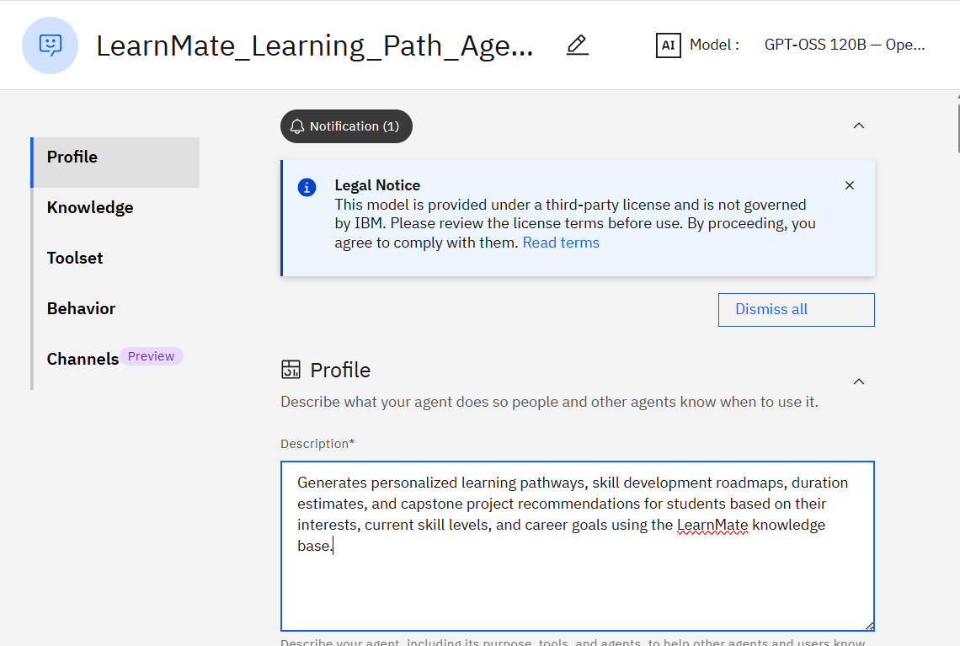
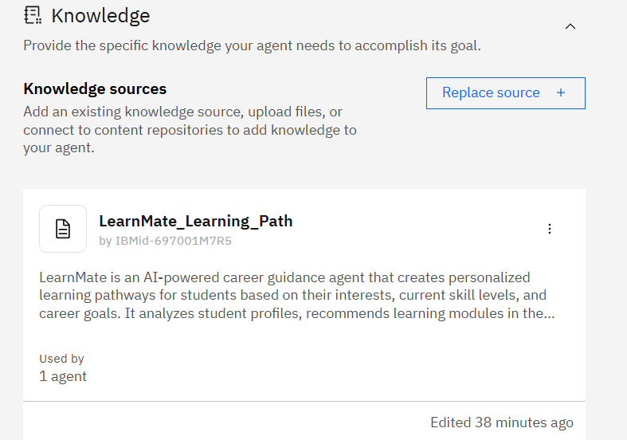
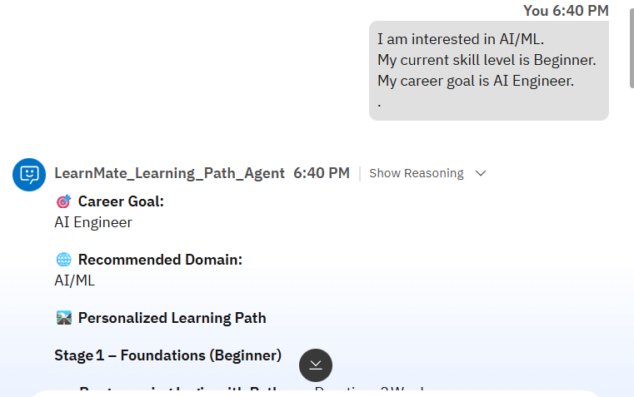
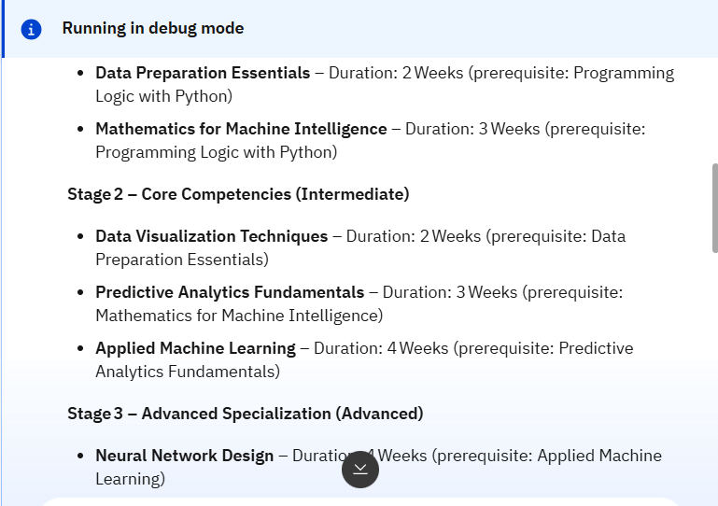
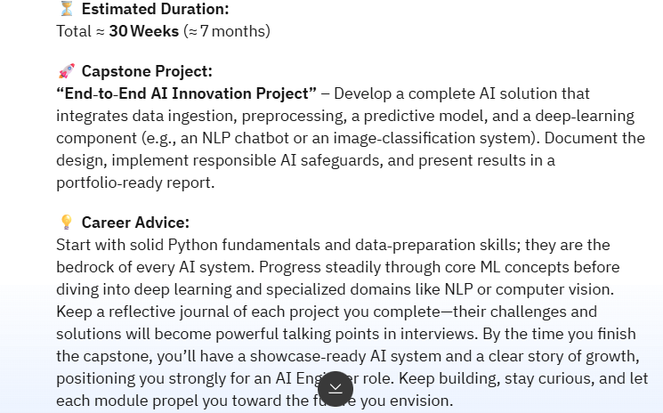
Results and Outputs:
Agent Configuration
Knowledge Base Setup
User Input
Generated Learning Path

Slide 10

Role of Agentic AI in the solution
Role of Agentic AI in AI Powered LearnMate
Agentic AI enables LearnMate to function as an intelligent career guidance system rather than a simple chatbot.
Using IBM watsonx Orchestrate and Granite Models, the system analyzes a student's interests, skill level, and career goals to generate personalized learning pathways.
The solution follows a multi-agent approach, where each agent performs a specific task.
The Learning Path Agent recommends suitable domains, learning modules, skills, duration estimates, and capstone projects.
The Progress Tracker Agent monitors completed modules and suggests the next learning steps.
Agentic AI makes LearnMate personalized, adaptive, and goal-oriented, helping students make informed career decisions and follow a structured learning roadmap toward their desired profession.

Slide 11
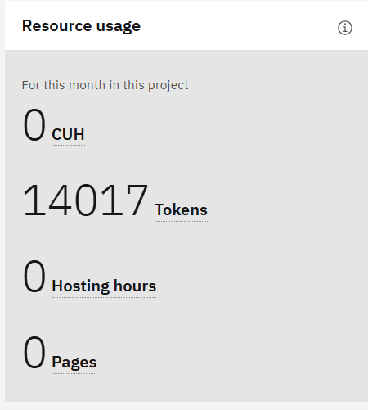
Project Testing & Resource Utilization
Project Outcomes
Generated personalized learning pathways based on student interests and career goals.
Recommended relevant domains, skills, learning modules, and capstone projects.
Reduced manual effort in planning career roadmaps through AI-driven automation.
Testing Summary
Agent Successfully Tested
Knowledge Base Successfully Integrated
RAG Retrieval Working
Personalized Learning Paths Generated
14,017 Tokens Utilized during Testing

Slide 12
Technology Used
• IBM watsonx Orchestrate : Used to design and manage the multi-agent workflow, enabling coordination between the agents.
• IBM Granite Model (Granite 3.2-8B Instruct) : Used for natural language understanding, reasoning, and generating personalized career guidance.
• Retrieval-Augmented Generation (RAG) : Retrieves relevant information from the LearnMate Knowledge Base before generating recommendations.
• Knowledge Base : Stores course details, prerequisites, skills , durations and career roadmap information.
• IBM Cloud : Provides a secure and scalable cloud environment for deploying and managing the LearnMate solution.
• GitHub : Used for version control, documentation, and project sharing.

Slide 13
Novelty and Uniqueness
AI Powered LearnMate combines Agentic AI, RAG, and personalized career guidance into a single intelligent platform.
Key Unique Features
Personalized Learning Paths : Generates customized learning roadmaps for every student.
Multi-Agent Architecture :Learning Path Agent and Progress Tracker Agent work together to generate personalized pathways and continuously track learner progress.
RAG-Based Knowledge Retrieval : Uses the LearnMate Knowledge Base to deliver accurate and relevant recommendations.
Duration Estimation : Provides estimated course completion timelines for better planning.
Career-Focused Recommendations : Suggests domains, skills, and capstone projects aligned with career objectives.
Progress Tracking : Tracks completed modules and recommends the next learning step.

Slide 14
Git Hub Link
· Please create public github repository (Enable Add README button while creating repository) with format –
Please test and Paste the working Github URL –
Make sure you have Uploaded following three files into your github repository 1) app.json file , 2) yourproblemstatement.pdf file 3) your projectpresntation.pptx file 4)any other files
·
·
·

Slide 15
Future Scope
Support More Career Domains –Expand the platform to support a wider range of career domains such as Data Science, Cloud Computing, DevOps, UI/UX Design, Blockchain, and Digital Marketing..
AI-Based Skill Gap Analysis –Analyze student skills and compare them with industry requirements to identify learning gaps and recommend improvement plans.
Advanced Progress Tracking Dashboard –Provide interactive dashboards with learning analytics, completion rates, skill progress, and goal tracking.
Job & Internship Recommendations – Recommend internships, certifications, and job opportunities aligned with a student's skills, interests, and completed learning path.
Mobile Application Integration – Develop a mobile app that allows students to access learning pathways, track progress, and receive career recommendations anytime and anywhere.
·
·
·

Slide 16


